Slide 1
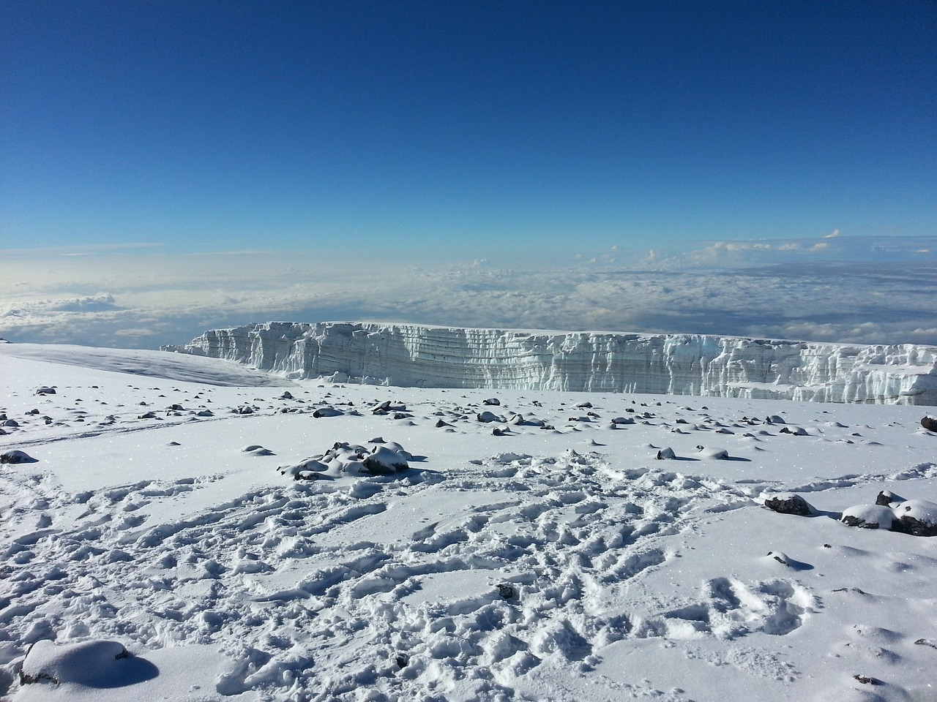
Pump it Up:
Tanzania Water Pump
By Shenghao (Lavender) Zhang

Slide 2
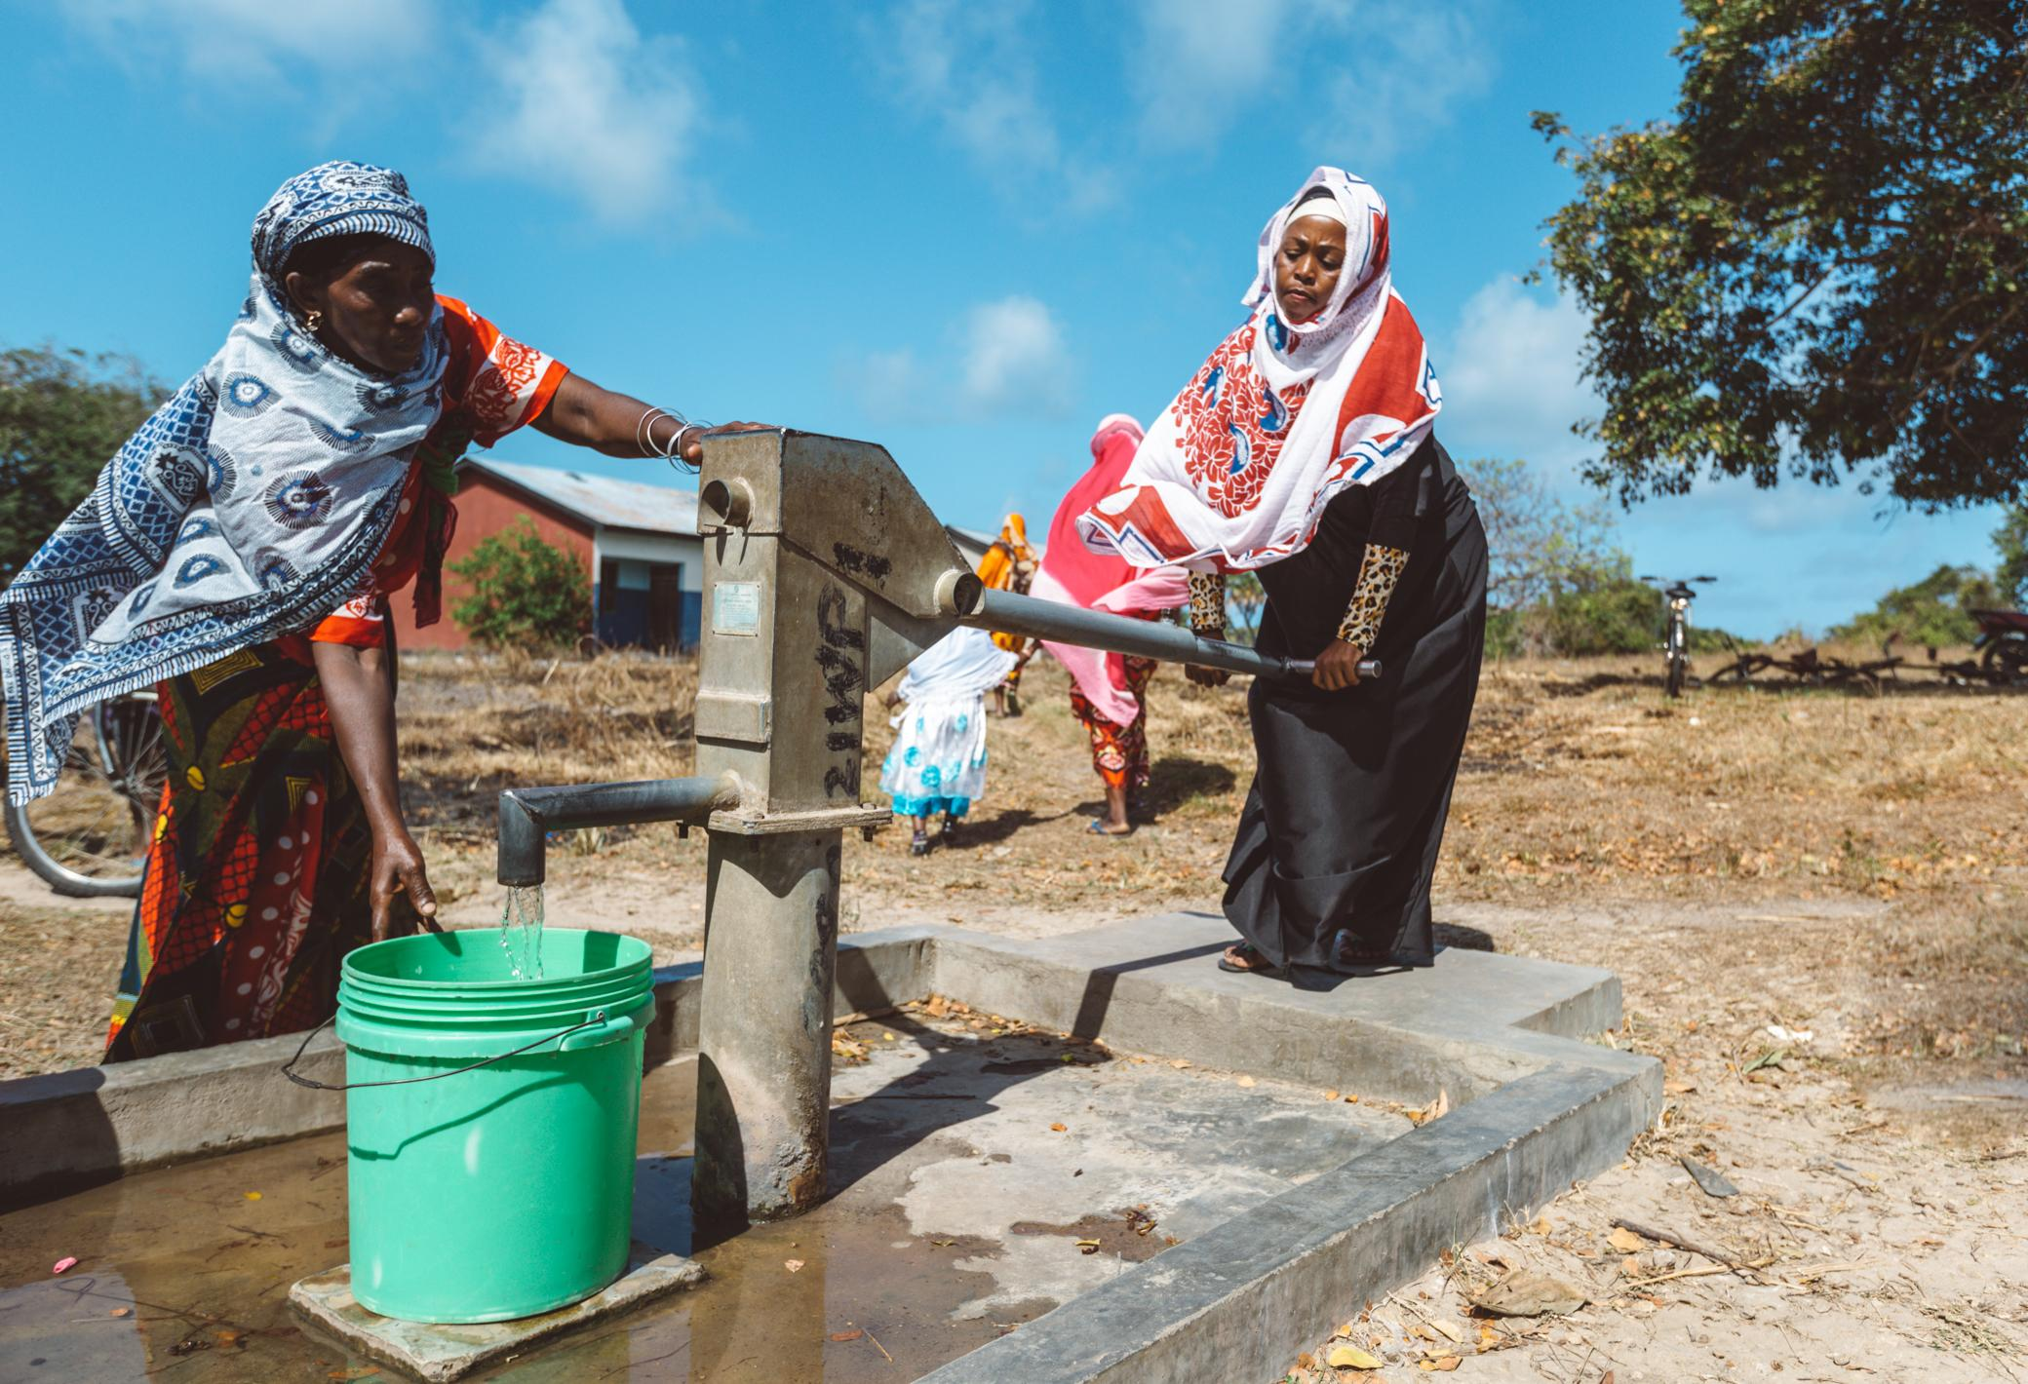
Agenda
Overview
Problems to Look at
Models
Findings

Slide 3

Overview
Potable water access is important to Tanzanians. Many areas use different types of water pump.
Can data help us to understand what’s behind the operation?

Slide 4
Problems to solve
Would water characteristics affect the operation of the pump?
Are there any geographical distribution of pumps in different functionality status?
1
3
2
Would human associated features affect the operation of the pump?
4
Are there any particular characteristics standing out that can affect the functional status of the pump?

Slide 5
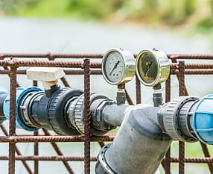
Graphs
& Finding
What have been spotted from the data analysis?

Slide 6
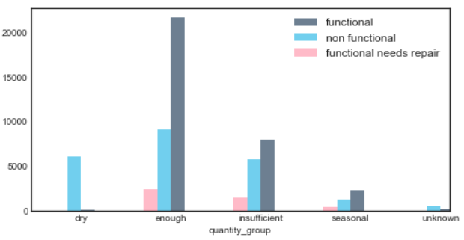
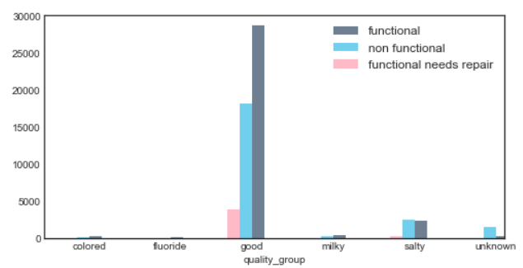
Water
Does quality and quantity affect pump operation?

Slide 7
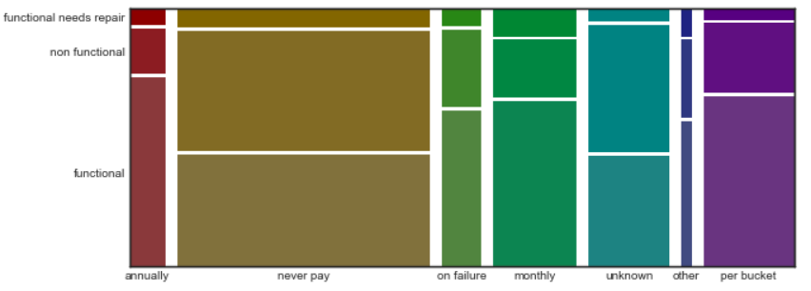
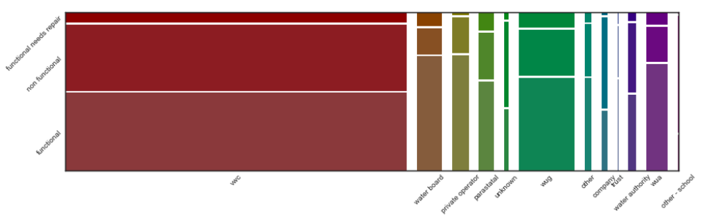
Operation
Payment & management vs functionality.

Slide 8
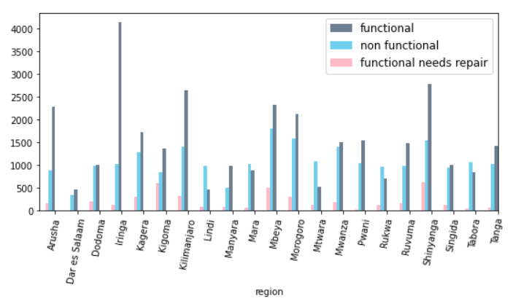
Geospatial
Three map plots showing geographical distribution of functional groups.
CEO
CFO
Sales Director
Berry Books
Vinny Viewer
Wendy Writer

Slide 9
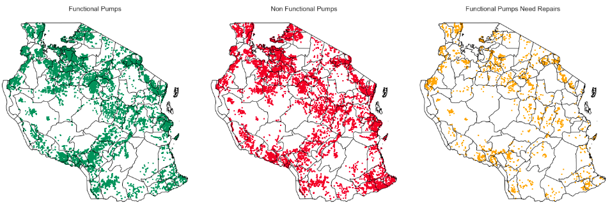
Geospatial
Three map plots showing geographical distribution of functional groups.
CEO
CFO
Sales Director
Berry Books
Vinny Viewer
Wendy Writer

Slide 10
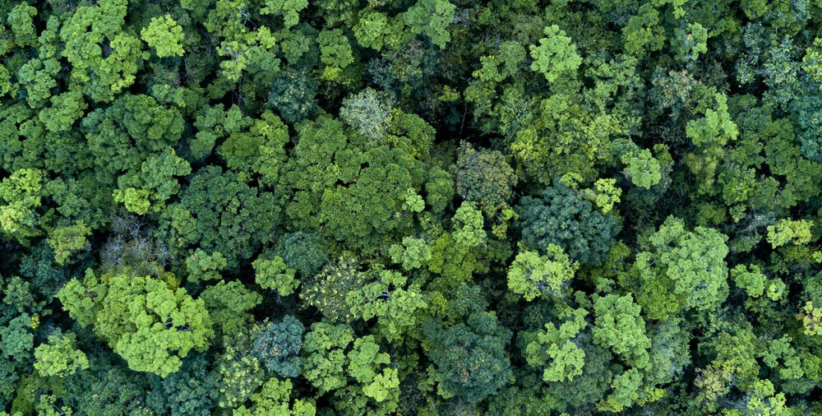


Models
K-Nearest Neighbour
XGBoost
Random Forest Classifier

Slide 11
Model’s Accuracy
KNN: 68%
RFC: 73%
XGBoost: 79%

Slide 12
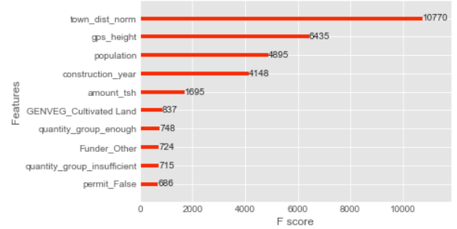
What variables are important?

Slide 13
Further Improvement Area
Deeper dive into the management, funding, and installing agencies
Predict the unknown value in quality and quantity.
1
3
2
Other economic factors to add into the study
4
User group for the pumps

Slide 14
Thank you.
Q&A?

